Slide 1


HEART DISEASE PREDICTION USING MACHINE LEARNING ALGORITHM
Tarun Sai Reddy Kummetha

Slide 2


PROBLEM STATEMENT
This project aims to know whether the patient has heart disease or not. The records in the datasets are divided into training sets and test sets. After pre-processing the data, data mining regression techniques will be applied. The results are generated for both training datasets and test datasets using Python Programming Language.

Slide 3


OBJECTIVE
Heart disease is one of the leading causes of death globally. Detecting heart disease early is vital to help patients get timely treatment.
Our solution would be to create machine learning models to predict heart disease using patient data. We will use past heart patient records to train classification models.
Key techniques like :
preprocessing
feature engineering
model validation
These will have to be utilize to maximize model accuracy. The outputs would help provide doctors insights into factors linked with heart disease. In the end, the overall goal is an automated system that serves as decision support for doctors utilized

Slide 4


DATA DICTIONARY
Data Contents:
There are 303 observations and 14 feature columns in the dataset. The feature columns represent various attributes and measurements related to patients like:
Age: age of the patient
Sex: gender of patient
Chest Pain Type: type of chest pain experienced
Resting BP: resting blood pressure
Cholesterol: cholesterol measurement
Fasting BS: fasting blood sugar measurement
Resting ECG: resting electrocardiogram results
Max HR: maximum heart rate achieved
Exercise Angina: exercise induced angina
ST Slope: peak exercise ST segment slope
The target variable is called 'Heart Disease’ and represents whether the patient has heart disease or not with values 0 (no disease) or 1 (has disease).
Data Characteristics:
Number of instances: 303
Number of Features: 13 clinical features
Target Variable: heart disease
Type of Learning: Supervised classification
Balanced classes: Nearly balanced data with 55% (165) negative class samples and 45% (138) positive class samples

Slide 5
Correlation Matrix
The correlation matrix showed important features like chest pain, max heart rate, slope, etc. have a high correlation to heart disease presence.
Checking the target variable distribution showed a nearly balanced dataset with about 45% minority (disease) class.
The feature distributions in the histograms showed normal distribution for most features.
Old peak seems to have a long tail distribution while thalach was left-skewed.

Slide 6
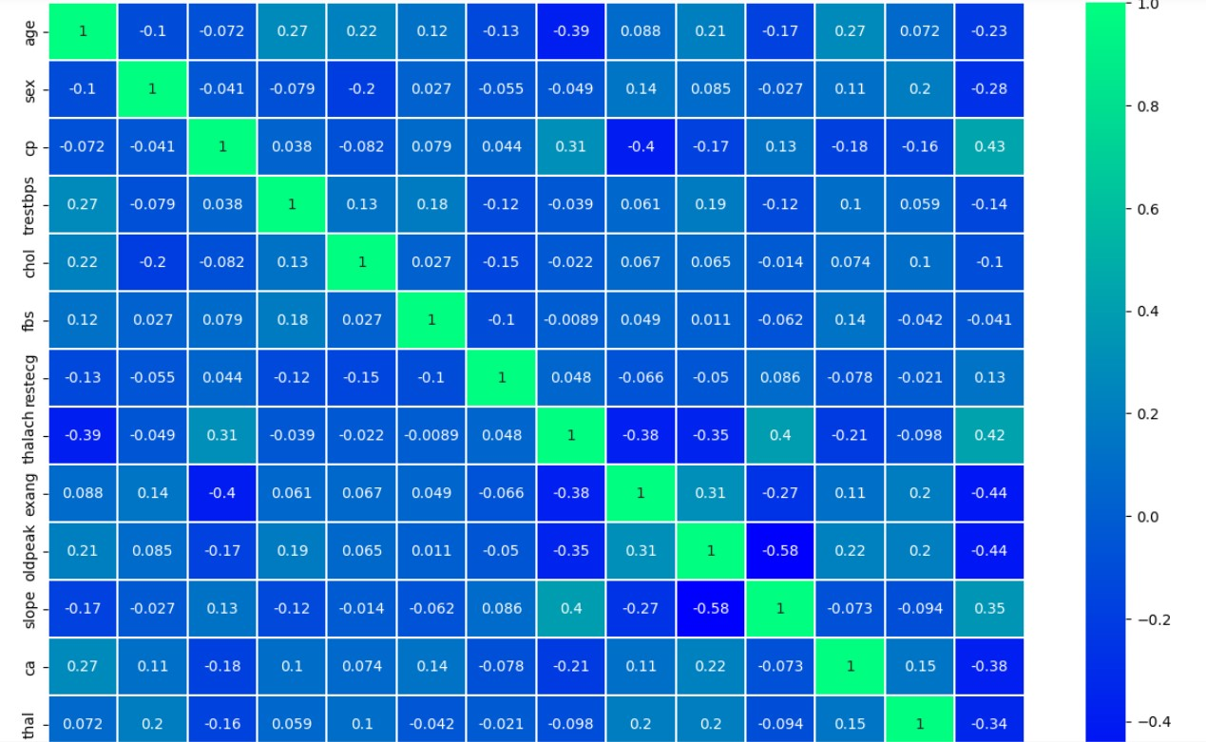
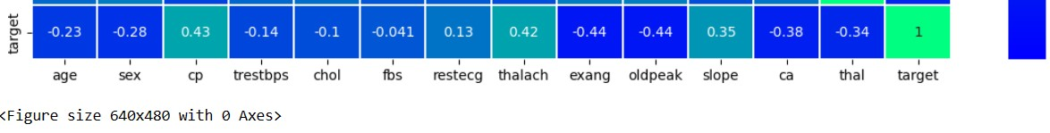

Slide 7

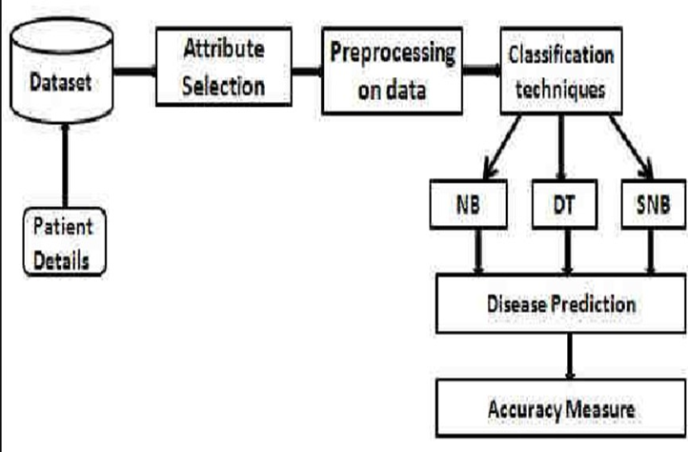
DATA MODEL

Slide 8
MACHINE LEARNING CLASSIFIERS
Here are the main machine learning classifiers that have been used for building models to predict heart disease in this project:
Logistic Regression
Decision Tree Classifier
Random Forest Classifier
SVM (Support Vector Machines)
K-Nearest Neighbors

Slide 9
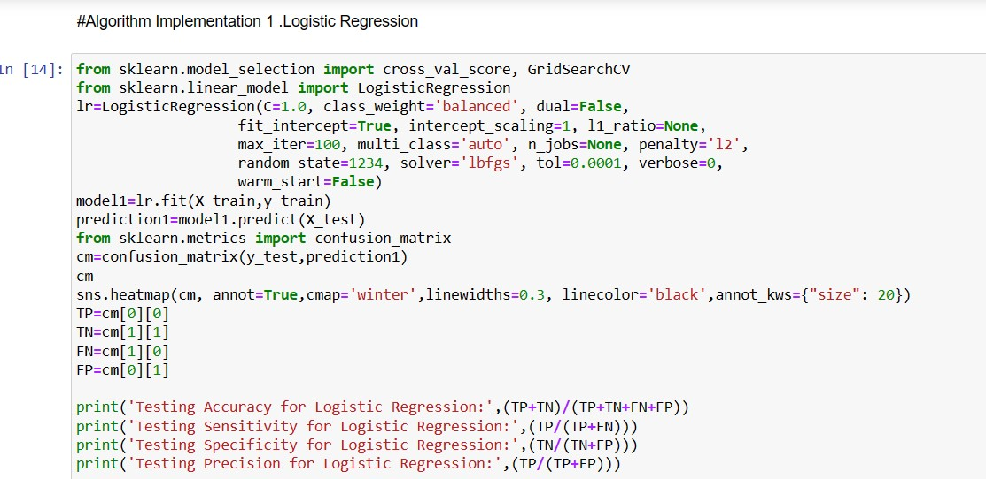

Logistic Regression
A basic linear classification algorithm
Assumes a logistic function relationship between input variables and output
Models probability of binary target variable using a logistic function
Simple and fast to train
Used as a baseline model

Slide 10

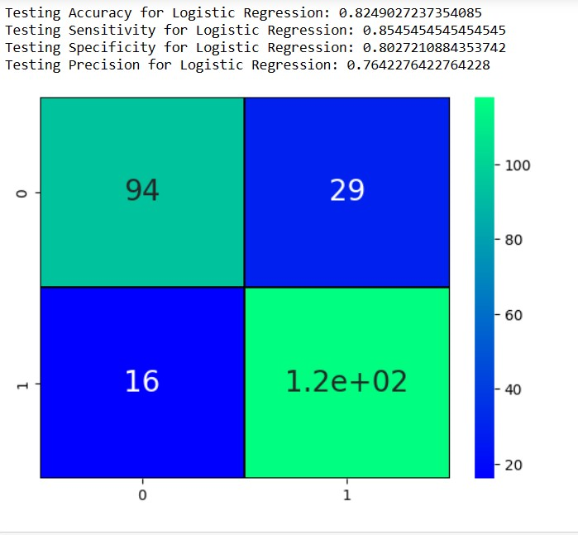
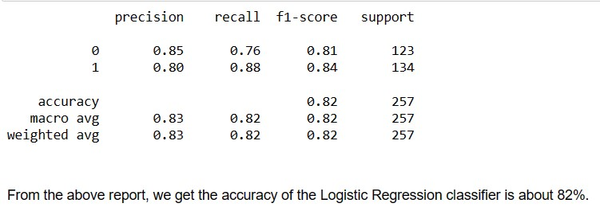


Slide 11
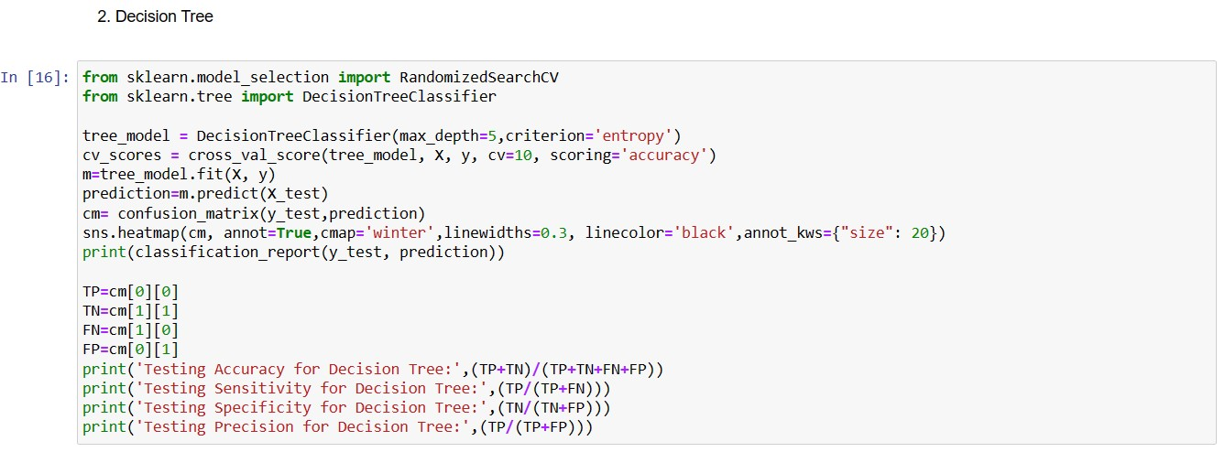
2. Decision Tree Classifier
Non-parametric tree-based classification
Learns decision rules from features to predict the target variable
Handles non-linear relationships well
Prone to overfitting

Slide 12
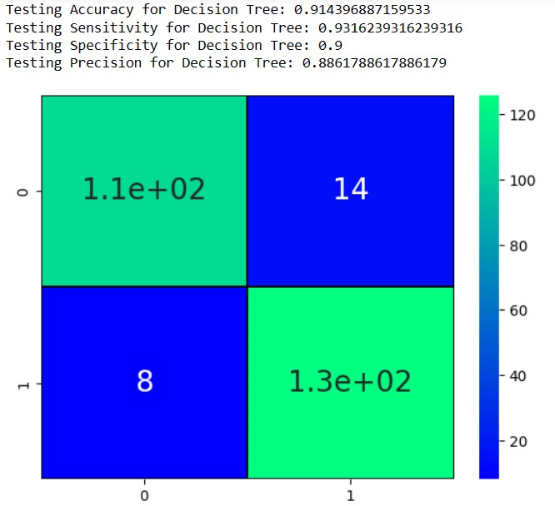
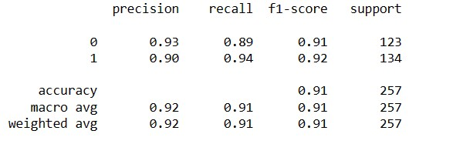
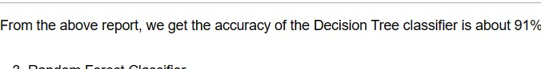

Slide 13
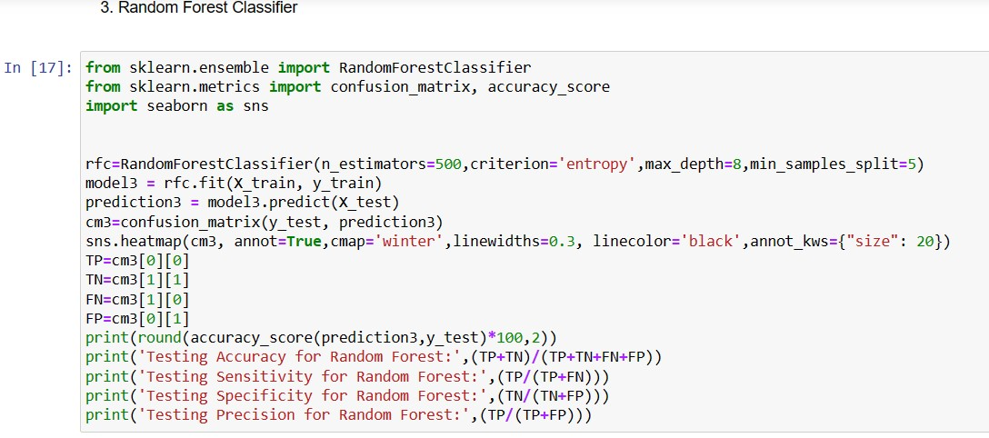
3. Random Forest Classifier
Ensemble method using many decision trees
Averages predictions from individual decision tree models
Provides higher prediction accuracy
Reduces overfitting vs single decision trees

Slide 14
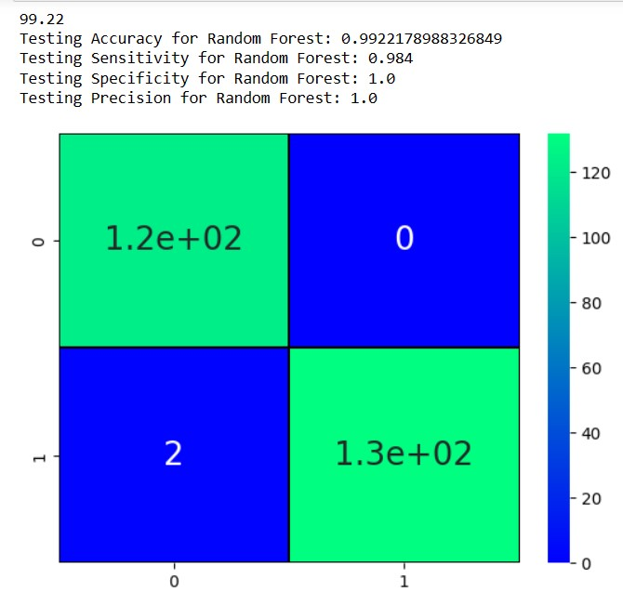
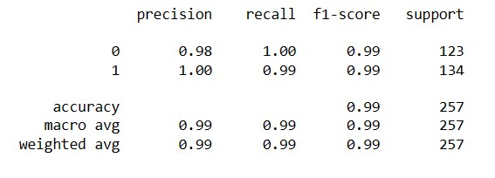

Slide 15
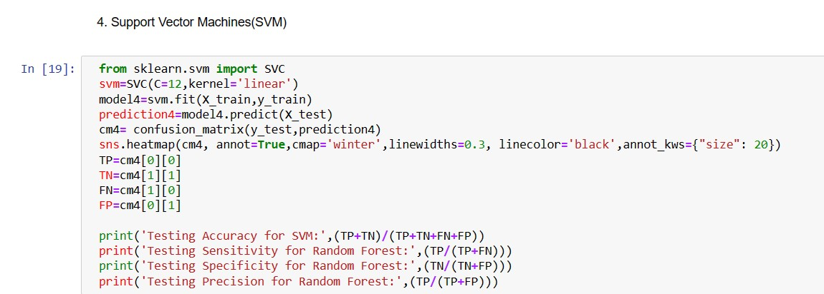
4. SVM(Support Vector Machines)
Finds optimal line/plane to separate classes
Effective for classification with clean data
Works well for low-dimensional spaces
Prone to overfitting with noisy data

Slide 16
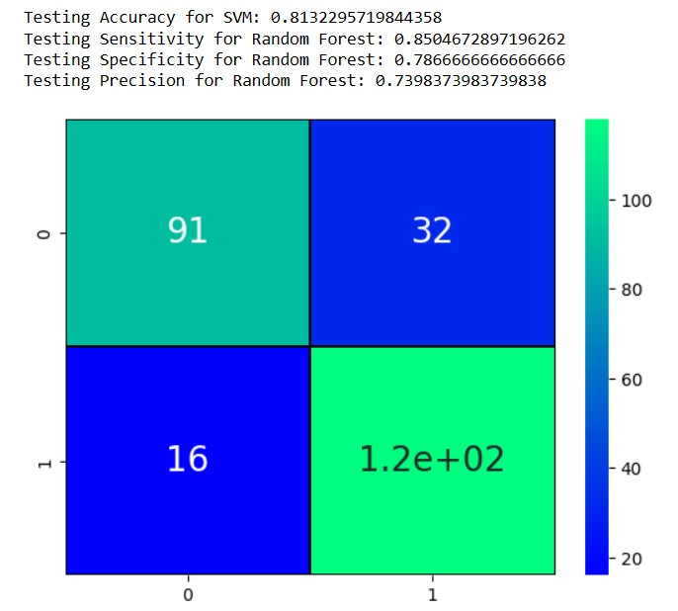
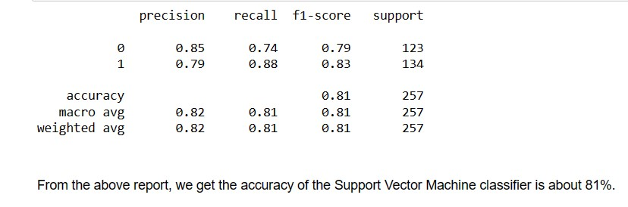

Slide 17
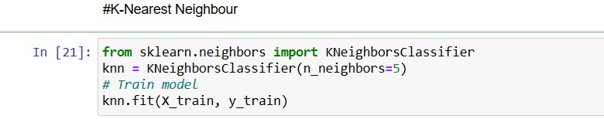
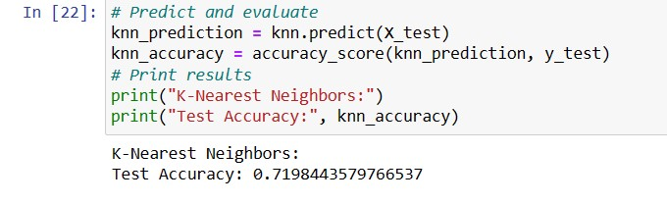
5. K-Nearest Neighbors
Non-parametric, instance-based learning
Makes predictions based on similarity/distance
Simple interpretation but expensive prediction stage

Slide 18
MODEL INSIGHT
The classification models were built and evaluated using accuracy, confusion matrix, classification metrics, etc. on the test set. The results were:
Logistic Regression: Accuracy - 82%
Decision Tree: Accuracy - 91%
Random Forest: Accuracy - 99%
SVM: Accuracy - 81%
KNN: Accuracy - 71%
The Random Forest model performed best with the highest accuracy of 99% this may be because of the nature of the classifier of overfitting the next best accuracy is achieved in the Decision Tree model with 91% accuracy.

Slide 19
The trained Decision Tree model was used to classify two new data samples
One sample was correctly classified as not having heart disease
The second sample was correctly classified as having heart disease
This demonstrates the model can work for real-world diagnosis scenarios by analyzing patient data to predict the likelihood of heart disease.
Decision Tree classifier has excellent performance in predicting heart disease risk
Key features like chest pain, heart rate, and their correlation to heart disease came out during the analysis
The model can work for real-world diagnosis predictions assisting healthcare professionals
Nearly 92% accuracy was achieved along with important insights around predictive factors for heart disease using this machine learning approach.

Slide 20

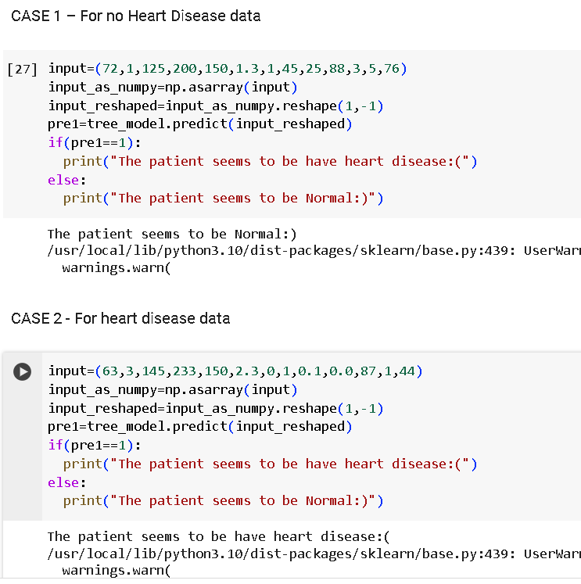

Final Model Implementation

Slide 21


CONCLUSION
In conclusion, this machine learning project demonstrated an effective approach for predicting heart disease risk. Various classification algorithms were developed using a real-world heart disease dataset. After comparative evaluation, the Random Forest model achieved the highest accuracy of 99% on test data.
The analysis provided insights into important patterns in the patient data related to heart disease diagnosis. Key features like chest pain type, heart rate, ST slope etc showed strong correlation to disease occurrence. Visualizations and distributions of the features and target variable provided a way to understand the data better.

